Slide 1
A Hybrid Approach for Detecting Automated Spammers in Twitter
By :
Polu Sai Ashish
Roll no:1009-19-862-032
Masters of computer Applications
Nizam College, Hyderabad
Under supervision :
Prof Ms Humera Shaziya
Department of Informatics
Nizam College

Slide 2
Contents
Screenshots of execution of Software
Test Cases & Test Procedures
Conclusion
Future Work
References

Slide 3
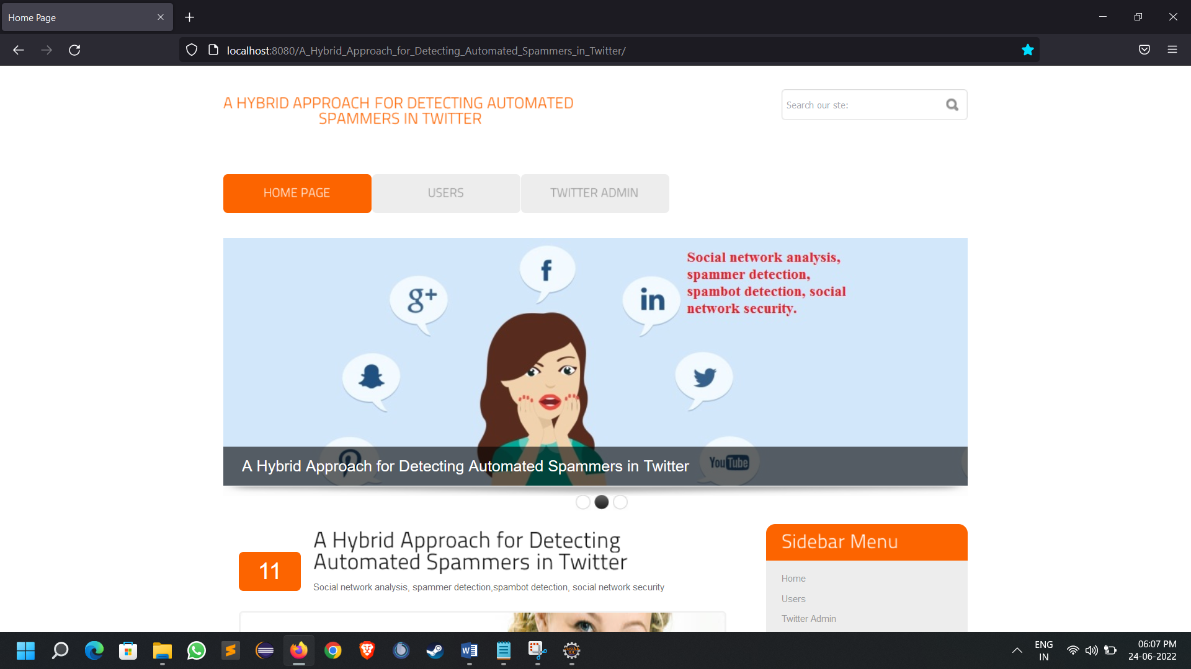
Screenshots of execution
Home page of the program

Slide 4
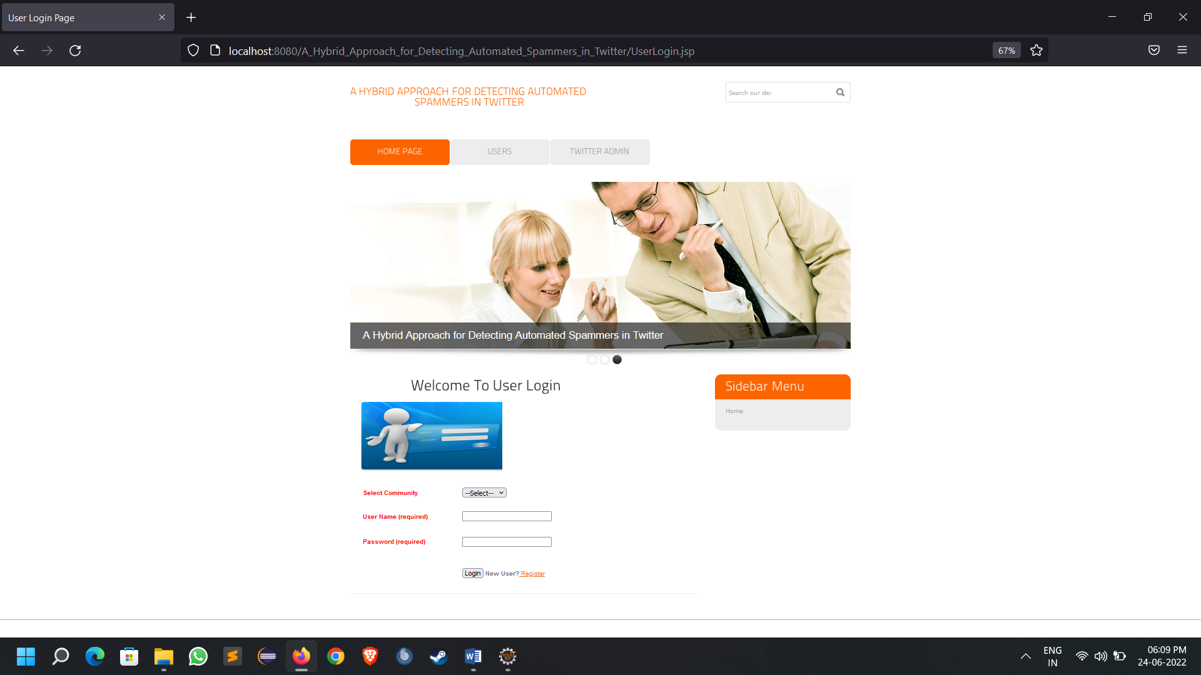
User login page

Slide 5
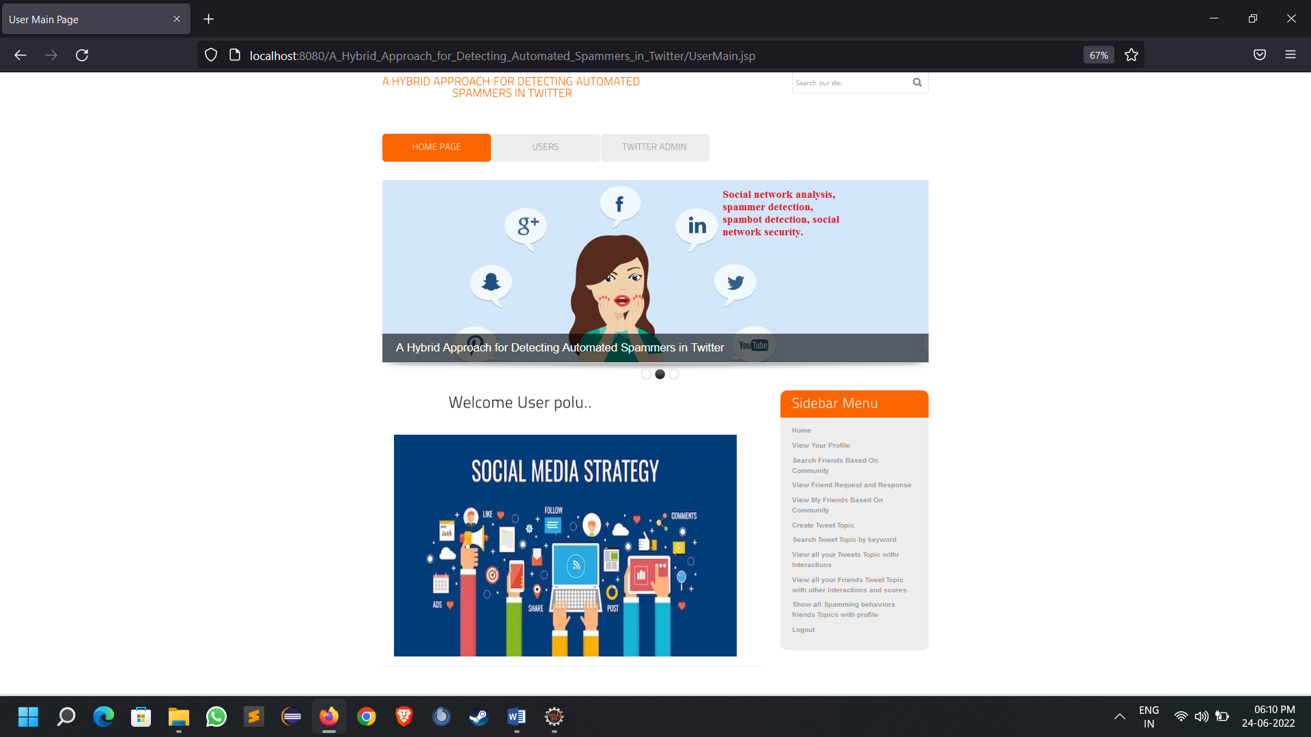
User successful login in to the web app

Slide 6
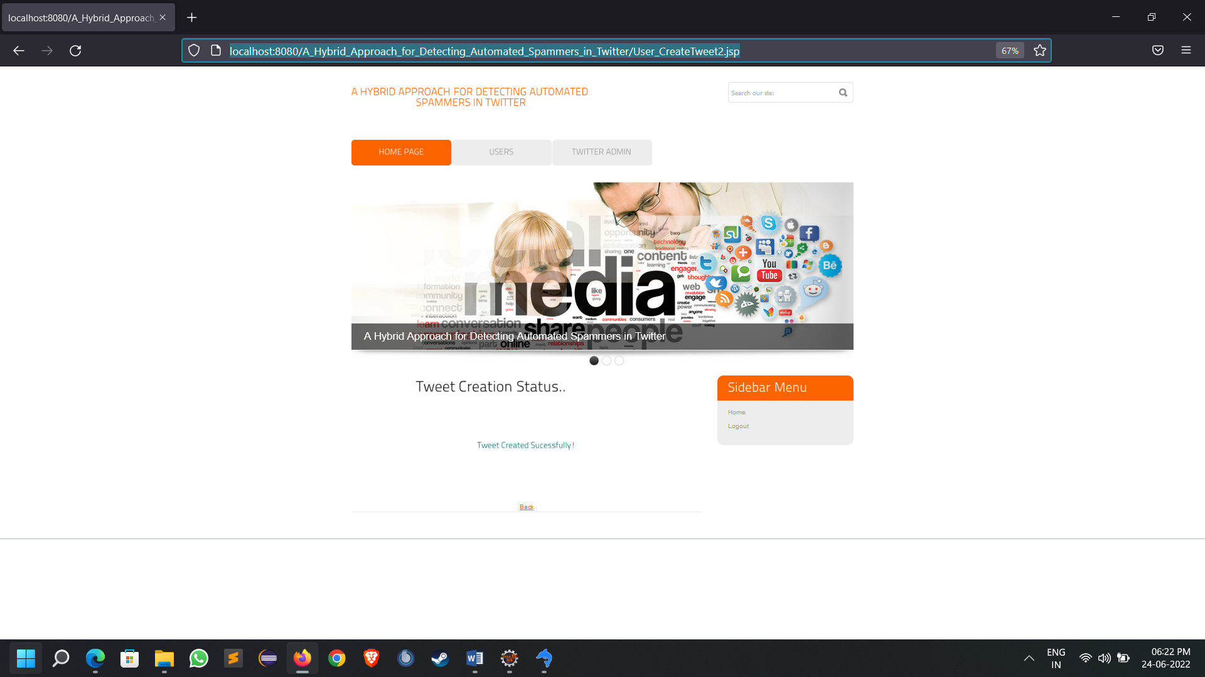
Successful creation of tweet

Slide 7
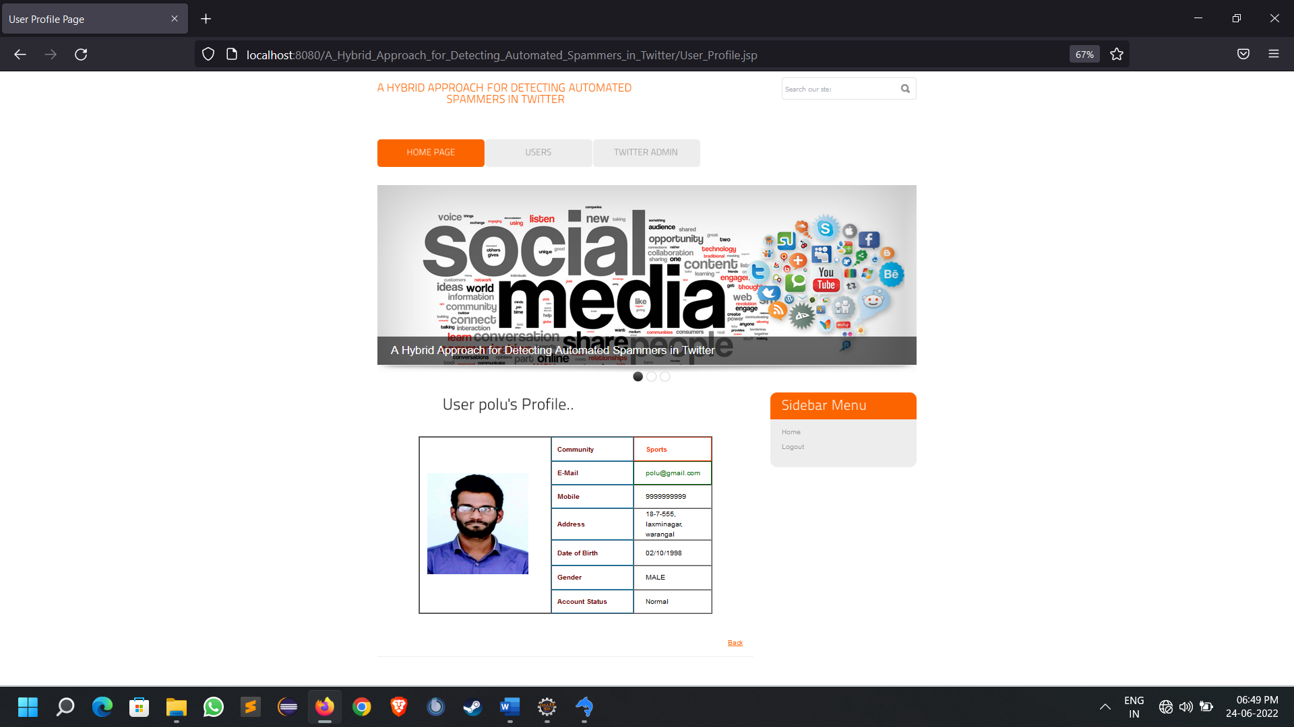
Viewing user profile

Slide 8
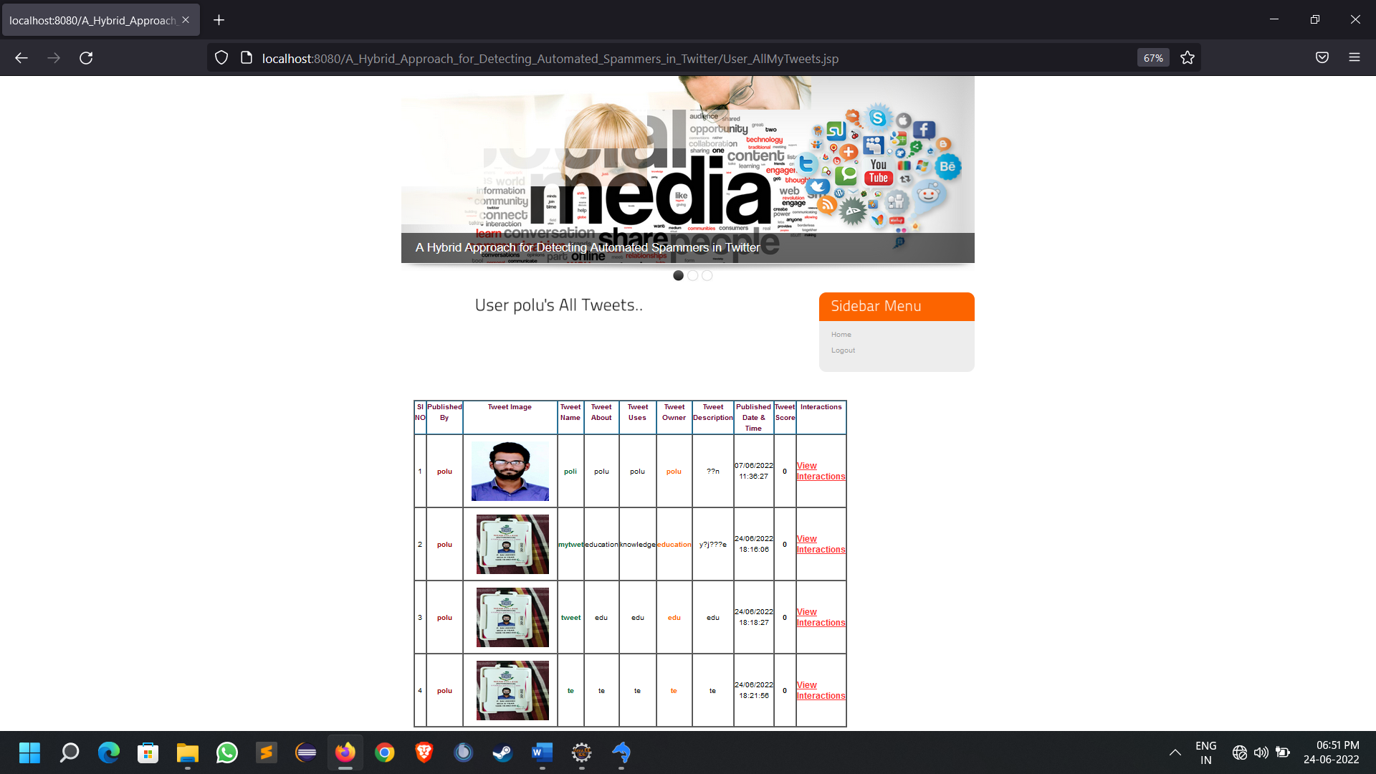
User looking at his all tweets

Slide 9
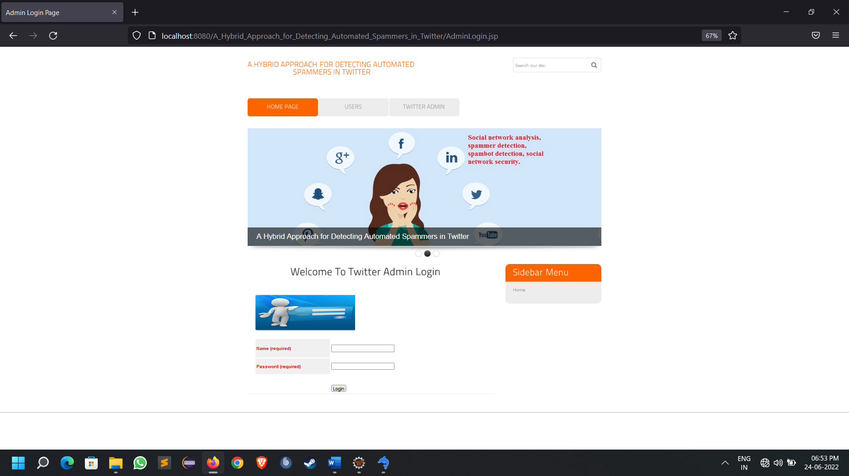
Admin login page

Slide 10
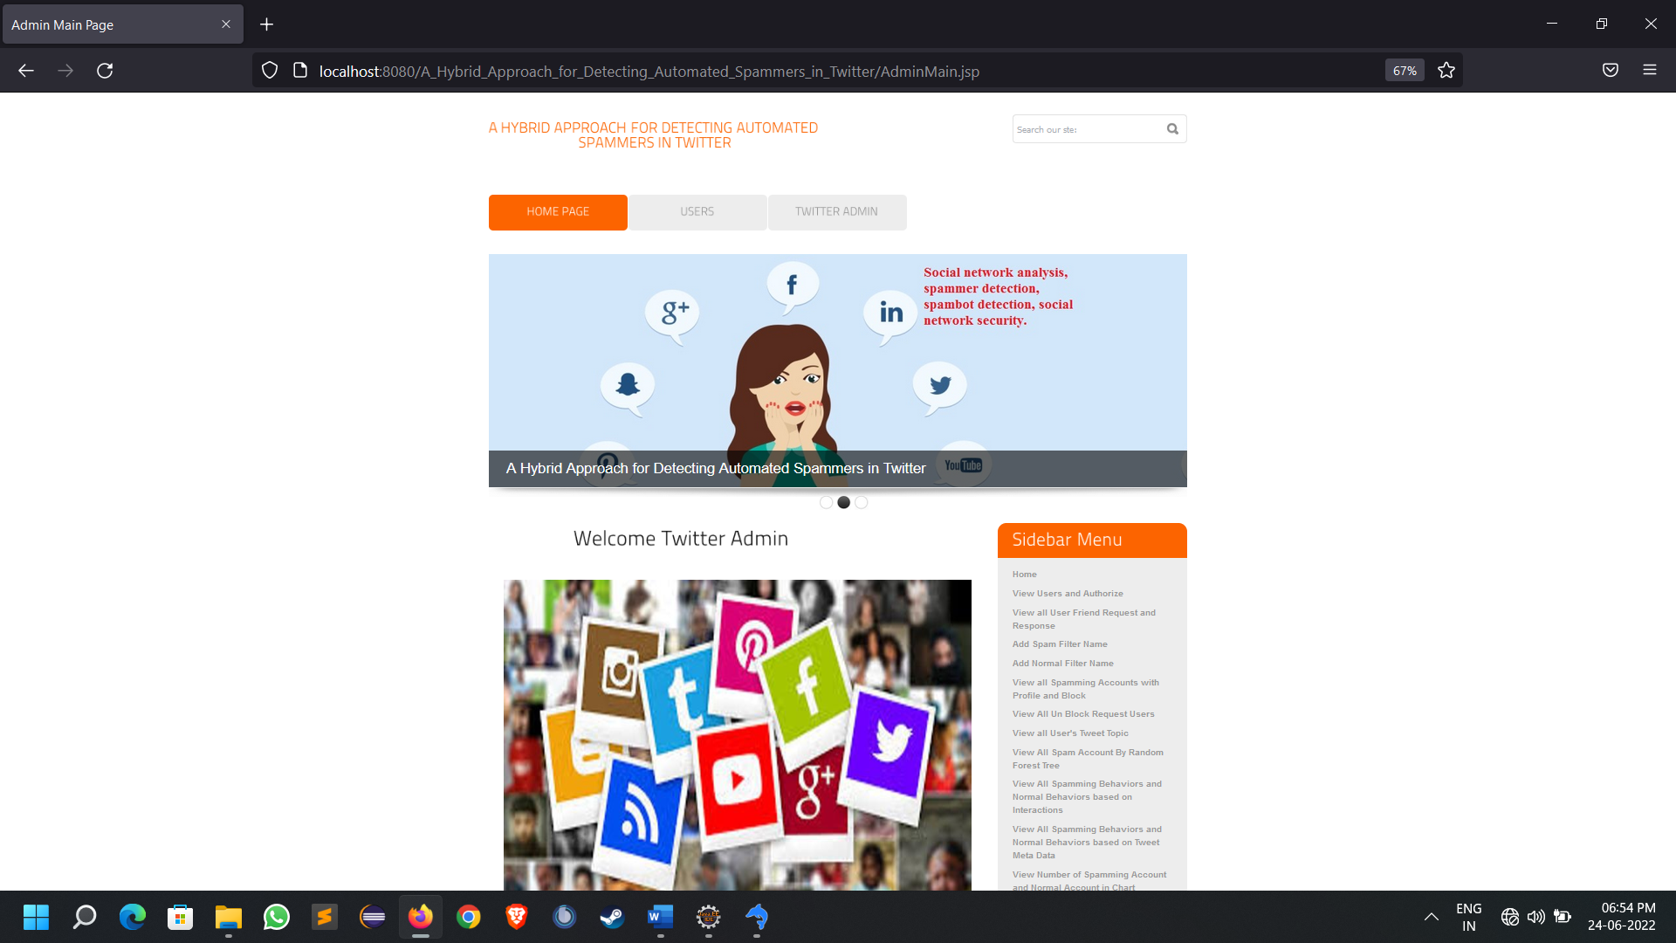
Admin welcome page

Slide 11
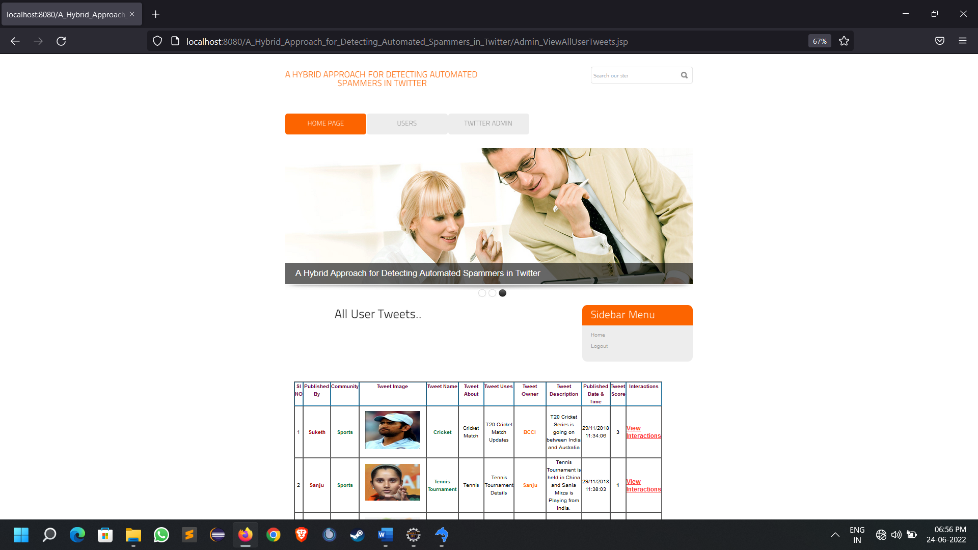
Admin viewing all user tweets for any spamming

Slide 12
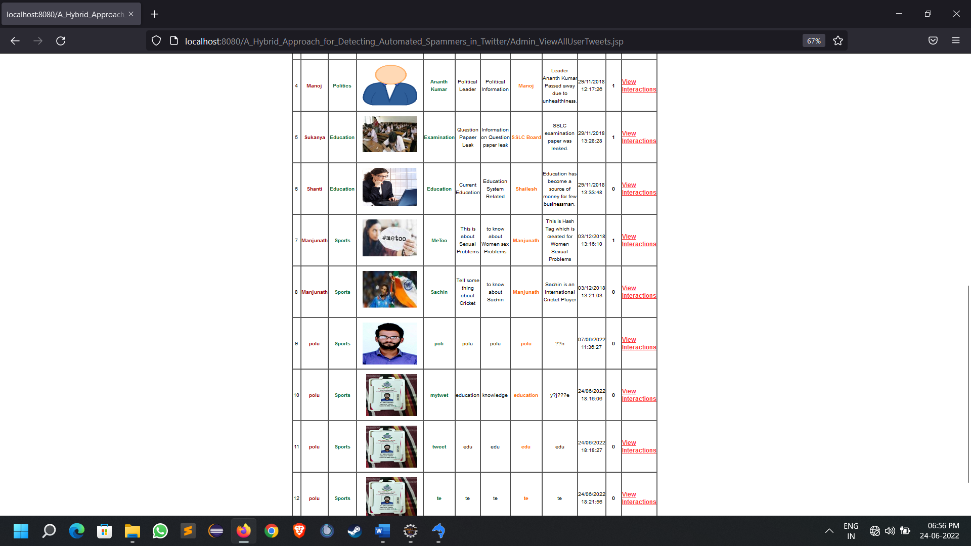

Slide 13
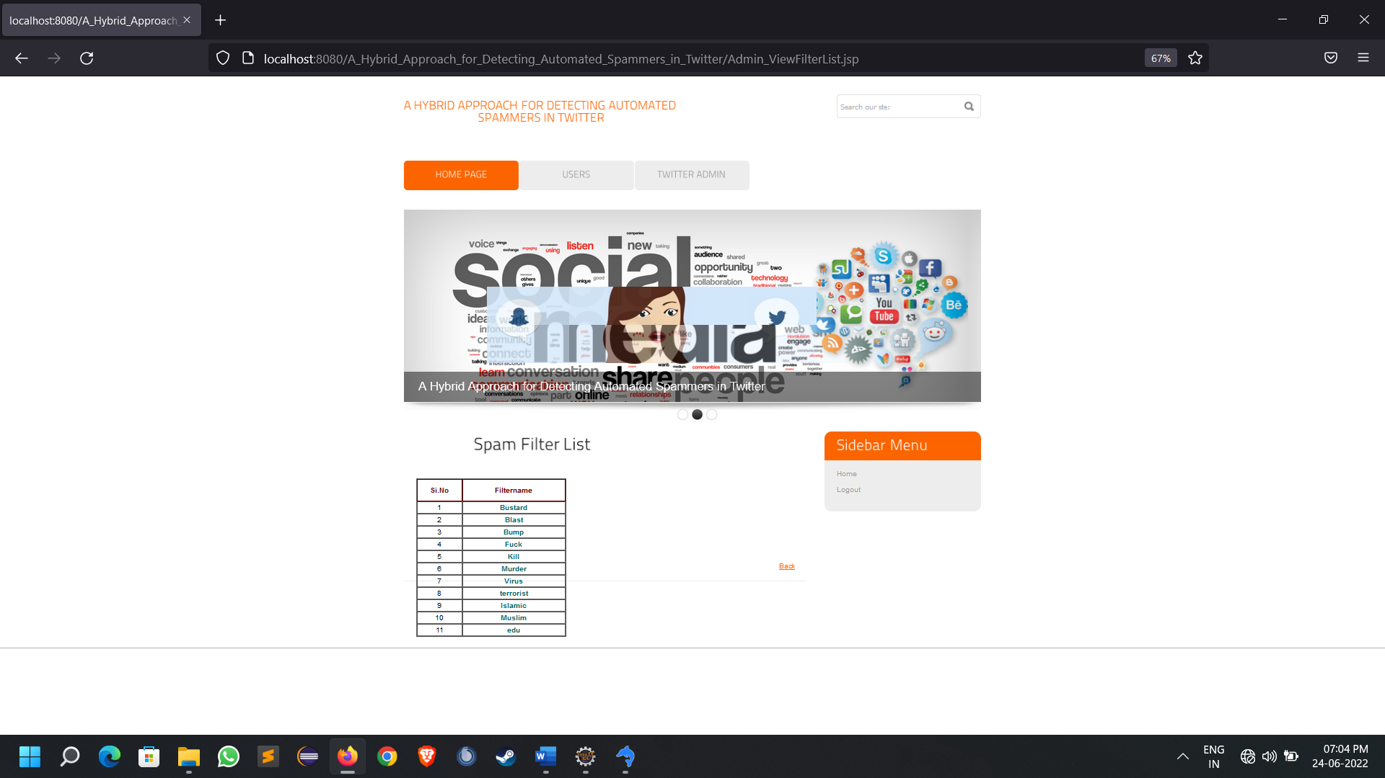
Predefined spam filter list

Slide 14
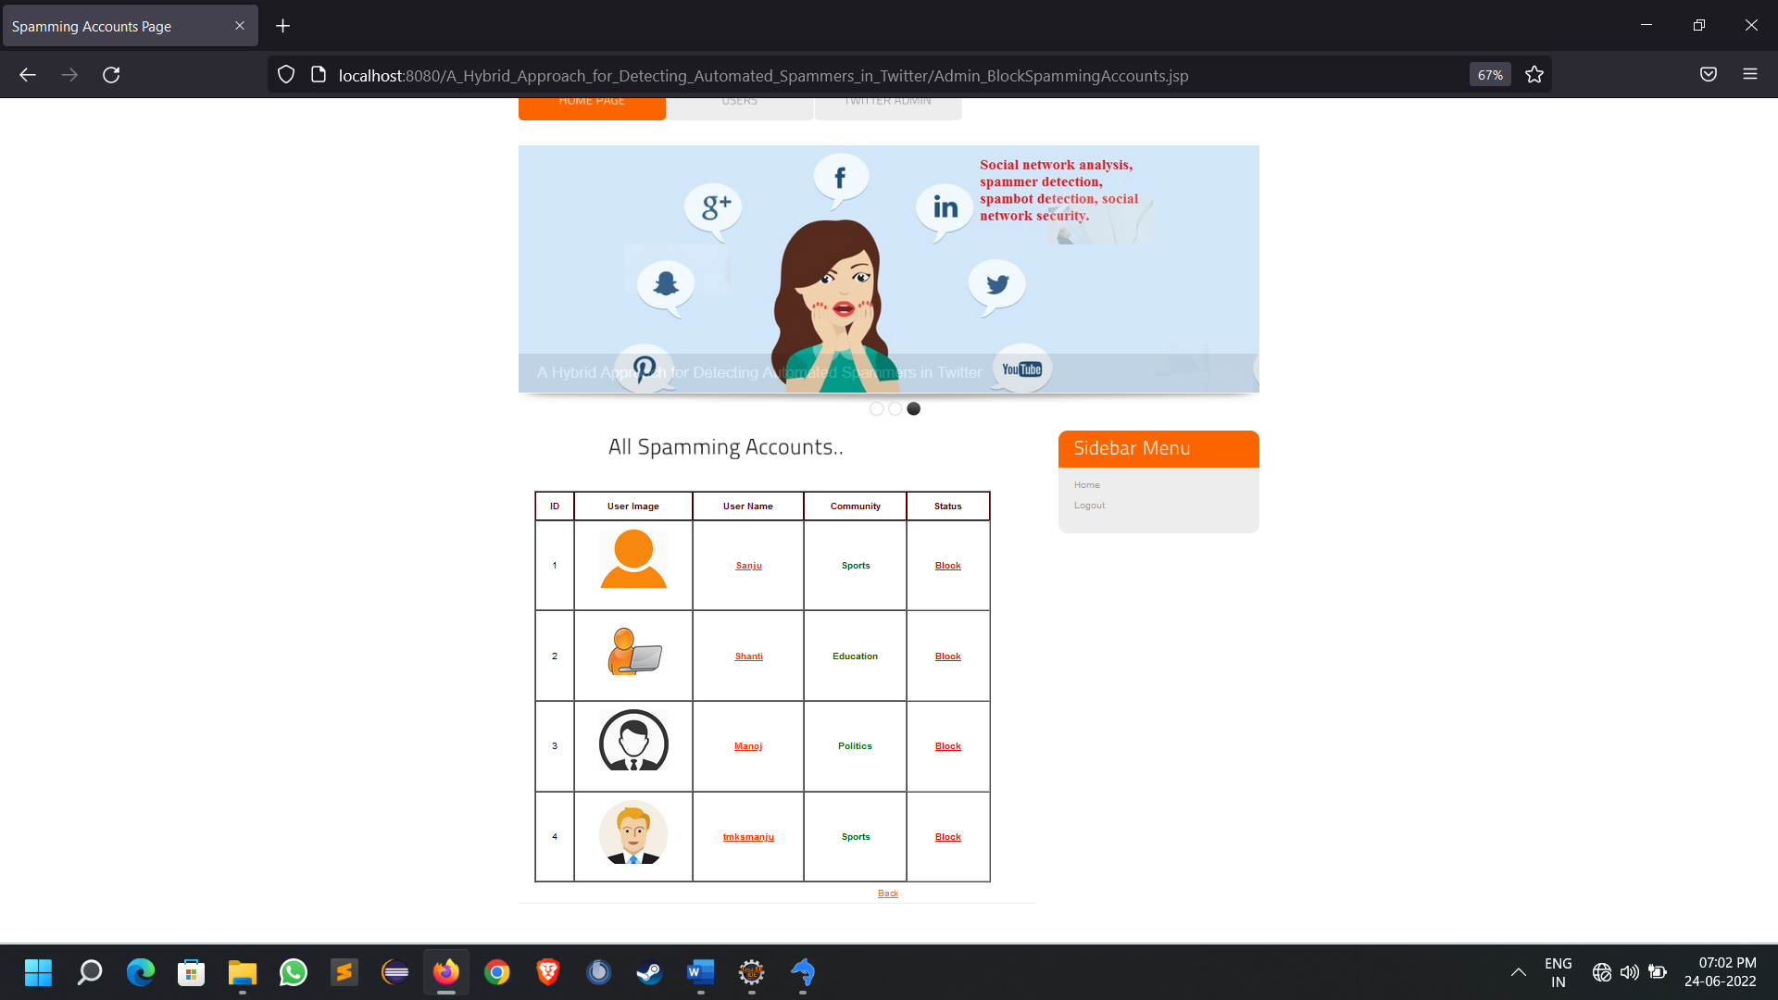
Admin looking at the spamming accounts based on the filters applied

Slide 15
Test cases
Positive test cases
The positive flow of the functionality must be considered
Valid inputs must be used for testing
Must have the positive perception to verify whether the requirements are justified.
For Example :
1.it should detect the spamming account by the analysing user tweet based on the given spam filters.
2.it should take valid login details for user and admin.

Slide 16
Negative Test Cases :
Must have negative perception.
Invalid inputs must be used for test.
Example:
1.error should be given when used to login with wrong details.
2.error request should be placed when tried to upload a tweet with missing blanks.

Slide 17
Conclusion
WORK DONE:
The “A Hybrid Approach for Detecting Automated Spammers in Twitter” was successfully designed and is tested for accuracy and quality.
During this project we have accomplished all the objectives and this project meets the needs of the organization. The developed will be used in searching, retrieving and generating information for the concerned requests.
GOALS
Reduced entry work.
Easy retrieval of information
Reduced errors due to human intervention
User friendly screens to enter the data
Portable and flexible for further enhancement
Web enabled.
Fast finding of information requested

Slide 18
Future work
It is not possible to develop a system that makes all the requirements of the user. User requirements keep changing as the system is being used. Some of the future enhancements that can be done to this system are:
As the technology emerges, it is possible to upgrade the system and can be adaptable to desired environment.
Because it is based on object-oriented design, any further changes can be easily adaptable.
Based on the future security issues, security can be improved using emerging technologies.
Attendance module can be added
sub admin module can be added
An in-built web browser can be added

Slide 19
References
[1] M. Tsikerdekis, “Identity deception prevention using common contribution network data,” IEEE Trans. Inf. Forensics Security, vol. 12, no. 1,pp. 188–199, Jan. 2017.
[2] T. Anwar and M. Abulaish, “Ranking radically influential Web forum users,” IEEE Trans. Inf. Forensics Security, vol. 10, no. 6,pp. 1289–1298, Jun. 2015.
[3] Y. Boshmaf, I. Muslukhov, K. Beznosov, and M. Ripeanu, “Design and analysis of social botnet,” Comput. Netw., vol. 57, no. 2, pp. 556–578,2013.
[4] D. Fletcher, “A brief history of spam,” TIME, Nov. 2, 2009.[Online]. Available:http://www.time.com/time/business/article/0,8599,1933796,00.html
[5] Y. Boshmaf, M. Ripeanu, K. Beznosov, and E. Santos-Neto, “Thwarting fake OSN accounts by predicting their victims,” in Proc. AISec, Denver,CO, USA, 2015, pp. 81–89.
[6] A. A. Amleshwaram, N. Reddy, S. Yadav, G. Gu, andC. Yang, “CATS: Characterizing automation of Twitter spammers,” in Proc. COMSNETS, Bengaluru, India, Jan. 2013, pp. 1–10.
[7] K. Lee, J. C. Lee, and S. Webb, “Uncovering social spammers: Socialhoneypots + machine learning,” in Proc. SIGIR, Geneva, Switzerland,Jul. 2010, pp. 435–442.
[8] G. Stringhini, C. Kruegel, and G. Vigna, “Detecting spammers on socialnetworks,” in Proc. ACSAC, Austin, TX, USA, 2010, pp. 1–9.
[9] H. Yu, M. Kaminsky, P. B. Gibbons, and A. D. Flaxman, “SybilGuard:Defending against sybil attacks via social networks,” IEEE/ACM Trans.Netw., vol. 16, no. 3, pp. 576–589, Jun. 2008.

Slide 20
[10] H. Gao, J. Hu, C. Wilson, Z. Li, Y. Chen, and B. Y. Zhao, “Detectingand characterizing social spam campaigns,” in Proc. IMC, Melbourne,VIC, Australia, 2001, pp. 35–47.
[11] W. Wei, F. Xu, C. C. Tan, and Q. Li “Sybildefender: Defend against sybil attacks in large social networks,” in Proc. INFOCOM, Orlando, FL, USA, Mar. 2012, pp. 1951–1959.
[12] C. Yang, R. C. Harkreader, and G. Gu, “Die free or live hard? Empirical evaluation and new design for fighting evolving Twitter spammers,” in Proc. RAID, Menlo Park, CA, USA, 2011, pp. 318–337.
[13] S. Lee and J. Kim, “WarningBird: A near real-time detection system forsuspicious URLs in Twitter stream,” IEEE Trans. Depend. Sec. Comput.,vol. 10, no. 3, pp. 183–195, May 2013.
[14] M. Sahami, S. Dumais, D. Heckerman, and E. Horvitz, “A Bayesianapproach to filtering junk e-mail,” in Proc. Workshop Learn. Text Categorization, Madison, WI, USA, 1998, pp. 98–105.
[15] C. Schäfer, “Detection of compromised email accounts used by a spam botnet with country counting and theoretical geographical travelling speed extracted from metadata,” in Proc. ISSREW, Naples, Italy,Nov. 2014, pp. 329–334.
[16] C. Schäfer, “Detection of compromised email accounts used for spamming in correlation with origin-destination delivery notification extracted from metadata,” in Proc. ISDFS, Tirgu Mures, Romania, Apr. 2017,pp. 1–6.
[17] A. H. Wang, “Detecting spam bots in online social networking sites:A machine learning approach,” in Proc. DBSec, Rome, Italy, 2010,pp. 335–342.
[18] F. Ahmed and M. Abulaish, “A generic statistical approach for spam detection in online social networks,” Comput. Commun., vol. 36,nos. 10–11, pp. 1120–1129, 2013.
[19] C. Yang, R. Harkreader, and G. Gu, “Empirical evaluation and new design for fighting evolving Twitter spammers,” IEEE Trans. Inf. Forensics Security, vol. 8, no. 8, pp. 1280–1293, Aug. 2013.
[20] Y. Zhu, X. Wang, E. Zhong, N. N. Liu, H. Li, and Q. Yang, “Discovering spammers in social networks,” in Proc. AAAI, Toronto, ON, Canada,2012, pp. 52–58.
[21] E. Tan, L. Guo, S. Chen, X. Zhang, and Y. Zhao, “Spammer behavioranalysis and detection in user generated content on social networks,”in Proc. ICDCS, Macau, China, Jun. 2012, pp. 305–314.
[22] S. Y. Bhat and M. Abulaish, “Community-based features for identifying spammers in online social networks,” in Proc. Int. Conf. Adv.Social Netw. Anal. Mining, Niagara Falls, ON, Canada, Aug. 2013,pp. 100–107.
[23] L. M. Aiello, M. Deplano, R. Schifanella, and G. Ruffo, “People are strange when you’re a stranger: Impact and influence of bots on socialnetworks,” in Proc. AAAI, Dublin, Ireland, 2012, pp. 10–17.
[24] S. Cresci, R. D. Pietro, M. Petrocchi, A. Spognardi, and M. Tesconi, “The paradigm-shift of social spambots: Evidence, theories, and toolsfor the arms race,” in Proc. WWW, Perth, WA, Australia, 2017,pp.

Slide 21
THANK YOU!

